Slide 1

EDA - Data Professionals
JIBOKU OLUWATUNMISE O.

Slide 2
Introduction
The demand for data-related roles has increased by 650% since 2012, with no signs of stopping. The U.S. Bureau of Labour Statistics predicts that demand for data science skills will increase by almost 28% by 2026, causing a shortage of 140,000 to 190,000 skilled professionals in the U.S. alone, according to McKinsey.
This high demand has led to competitive salaries for data professionals, based on various criteria such as roles, experiences, and locations. A dataset of 607 data professionals provided by 10alytics was analyzed using Python and EDA to explore the factors that affect their salaries.

Slide 3

Initial Findings
Univariate analysis

Slide 4
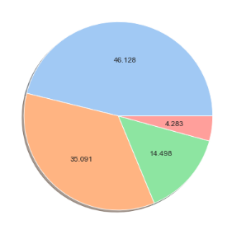
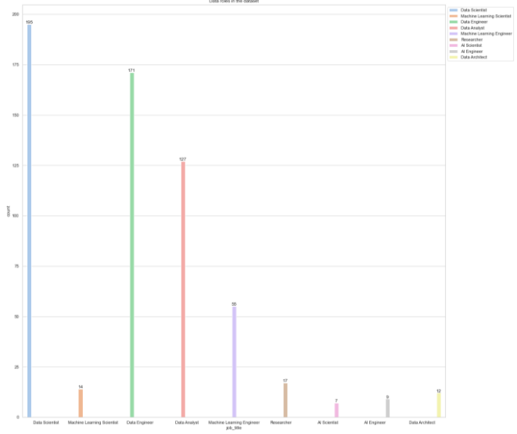

Majority of data professionals operate in the mid level while only a minority operate at expert level.
Based on roles, majority of professionals are data scientists, while a few are specialists in AI solutions.
Almost all roles were fulltime roles while freelance roles are almost nonexistent in data

Slide 5
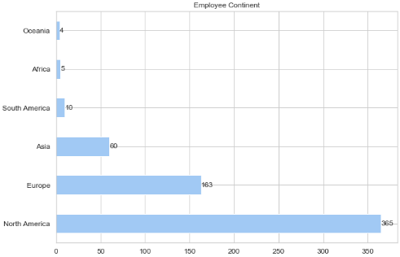
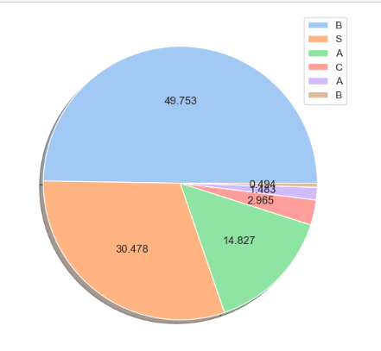
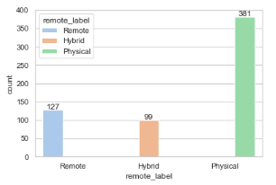
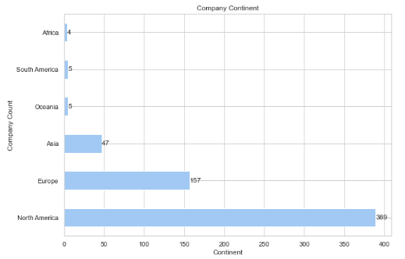
Remuneration of most of data professionals ranges between $50,000 and $99,999. The least grouped payment is between $4999 and $0.
Majority of data professionals work physically while remote and hybrid roles come close in contrast.
Majority of data professionals and employers of data professionals are located at North America

Slide 6
Advanced Findings
Multivariate analysis

Slide 7
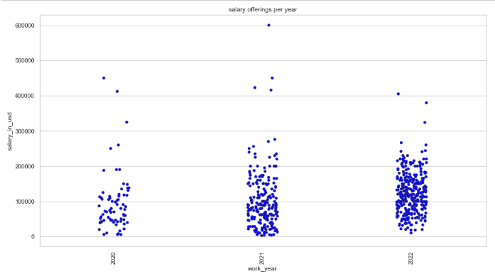
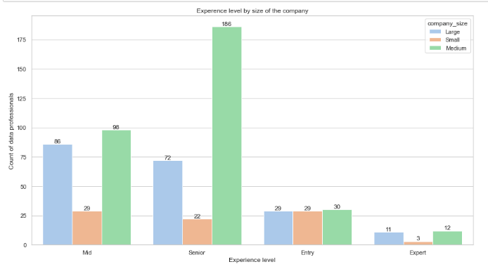
Between 2020 and 2022, the salaries offered amongst data professionals varied. The amount of salaries paid increased gradually from 2021 to 2022. Although, higher payout, were given in 2020 and 2021 than in 2022.
Majority of data professionals operated at senior level which was the most hired level across the various sizes of companies. Moreover, medium sized companies hired data professionals the most.

Slide 8
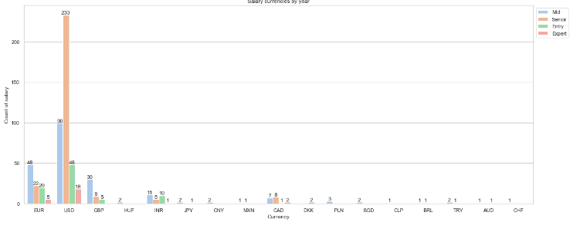
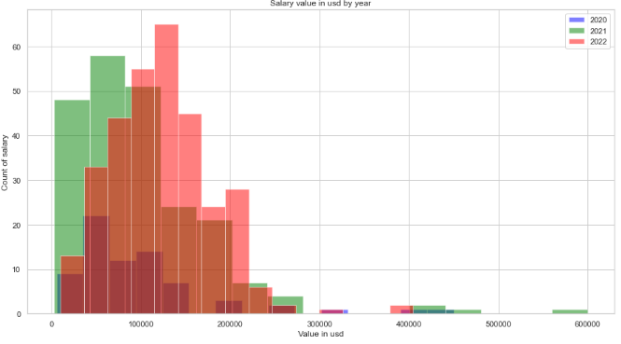
In terms of currencies, USD is the most offered currency as remuneration for data professionals across the various experience levels.
2021 offered higher pays to data professionals than both 2022 and 2020.

Slide 9
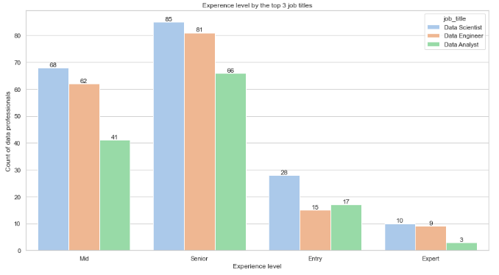
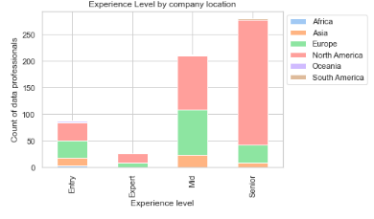
North America contains the majority of data professionals across all experience levels. South America, Oceania, and Africa have few data professionals operating in the various experience levels.
Among the 3 major data professions, majority of individuals operate at senior level. There also seem to be lack of experts among data analysts.

Slide 10
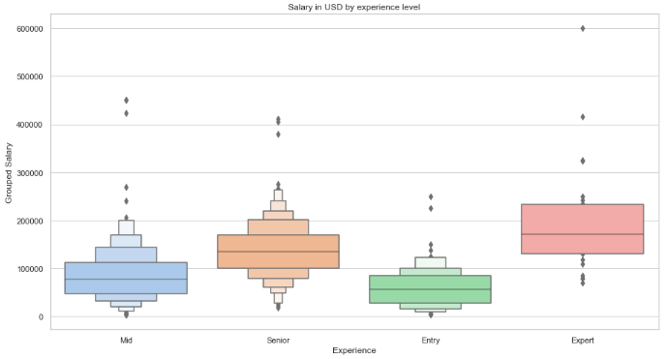
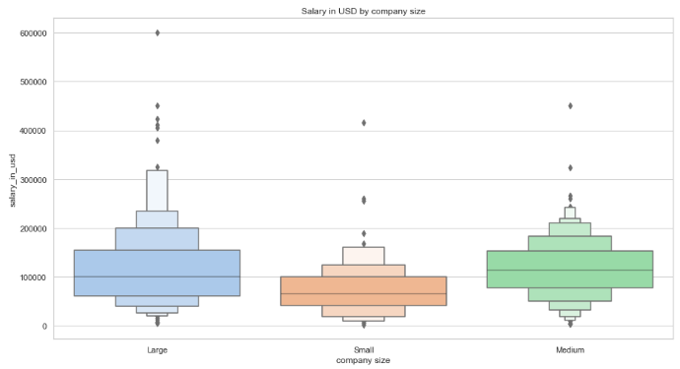
Data professionals who have expertise in their roles were paid higher than any other experience level while those at entry level were paid lower. It also shows that the mean of entry level salary is around the least of an expert’s salary.
Amongst the three company sizes, both medium and the large companies offer similar average payment for the services of data professionals, although, the large companies pay higher than the medium companies.

Slide 11
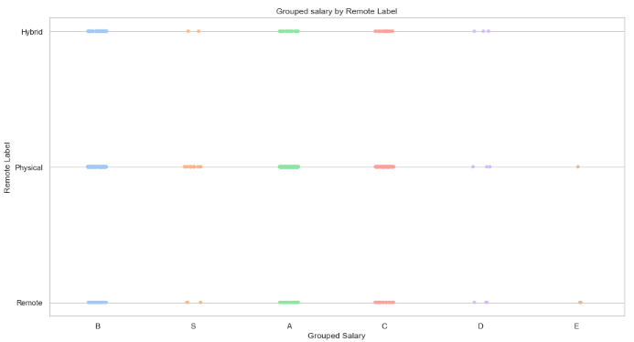
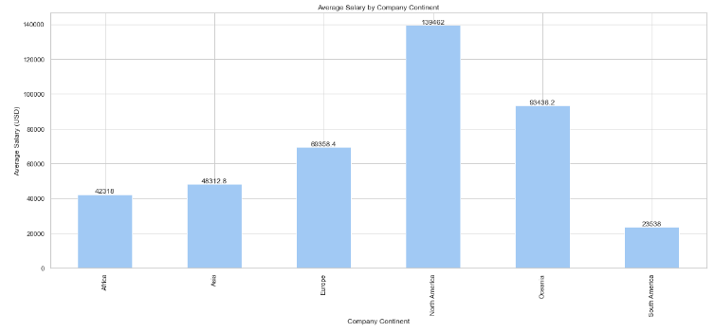
Hybrid roles offer data professionals a higher chance of convenient pay.
North American companies have the highest average salary payout while South American companies have the least.

Slide 12




THANK YOU
Send me a DM for any data related project you need.
Contacts:
https://www.linkedin.com/in/oluwatunmise-jiboku-4979a0212/
https://twitter.com/j_oluwatunmise/
https://github.com/Jiboku-Oluwatunmise/
oluwatunmisejiboku@gmail.com

